Slide 1


Social Buzz Engagement Overview

Slide 2


Today's agenda
Project recap
Problem
The Analytics team
Process
Insights
Summary

Slide 3

Social Buzz is a fast growing technology unicorn that need to adapt quickly to its global scale. Accenture has begun a 3 month POC focusing on these tasks:
An audit of their big data practice
Recommendations for a successful IPO
An analysis of their content categories that highlights the top 5 categories
Project Recap

Slide 4

Problem
Over 100000 posts per day
36,500,000 pieces of content per year!
Question is how to capitalize on it when there is so much?
Analysis to find Social Buzz’s top 5 most popular categories of content

Slide 5



Andrew Fleming
Chief Technical Architect
The Analytics team
Marcus Rompton
Senior Priniciple
Lekshmi L
Data Analyst

Slide 6
Process
1
Data Understanding
Data Cleaning
2
Data Modelling
3
Data
Analysis
4
5
Uncover Insights

Slide 7

Insights
16
Unique
Categories
1897
Reactions to ‘Animal’ Posts
January
Month with most posts

Slide 10

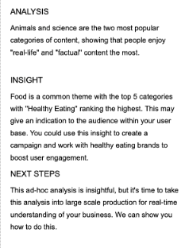
Summary

Slide 11
Thank you!
ANY QUESTIONS?

